Slide 1
CSE434 Group Project
Developing a Multithreaded – Multiuser Chat Application

Slide 2
GROUP MEMBERS
Mahfuja Khanam - 2021967
Israt jahan Kathamoni - 2020586
Mst Aroni Begum – 1910018

Slide 3
Development Tools and Environment
NetBeans IDE 14
JDK 18
Windows 11 Operating System

Slide 4
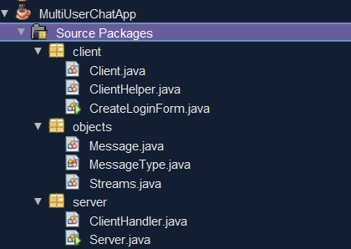
Project Structure

Slide 5
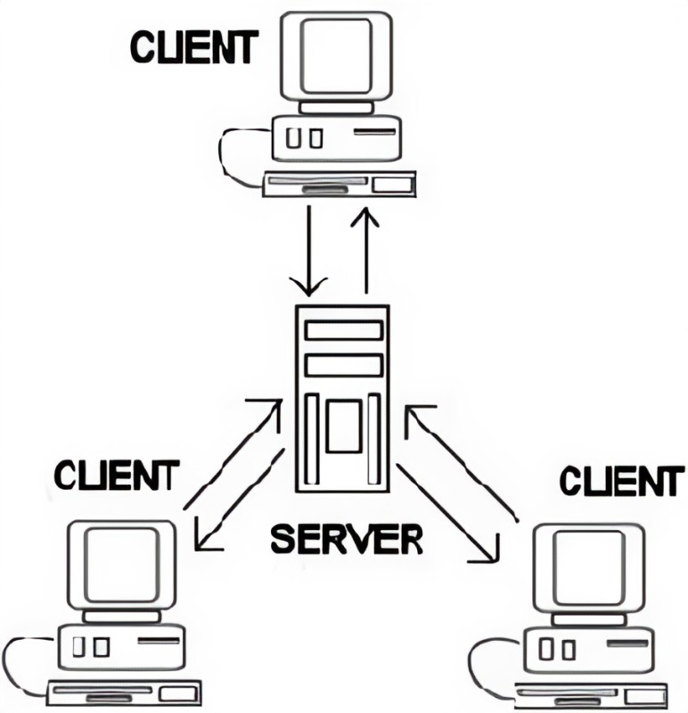
Conceptual Diagram

Slide 6
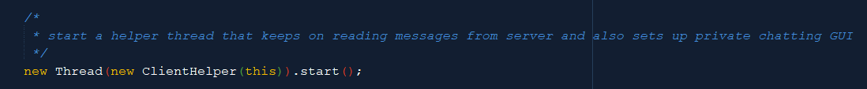
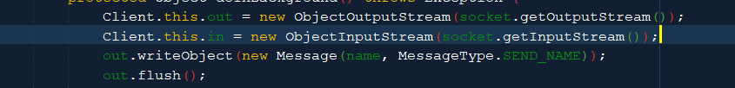
Concepts Implemented
Multithreading
Avoiding race conditions
Chaining filters for streams

Slide 7
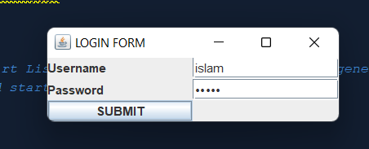
Concepts Implemented
Error logging
Client Authentication

Slide 8
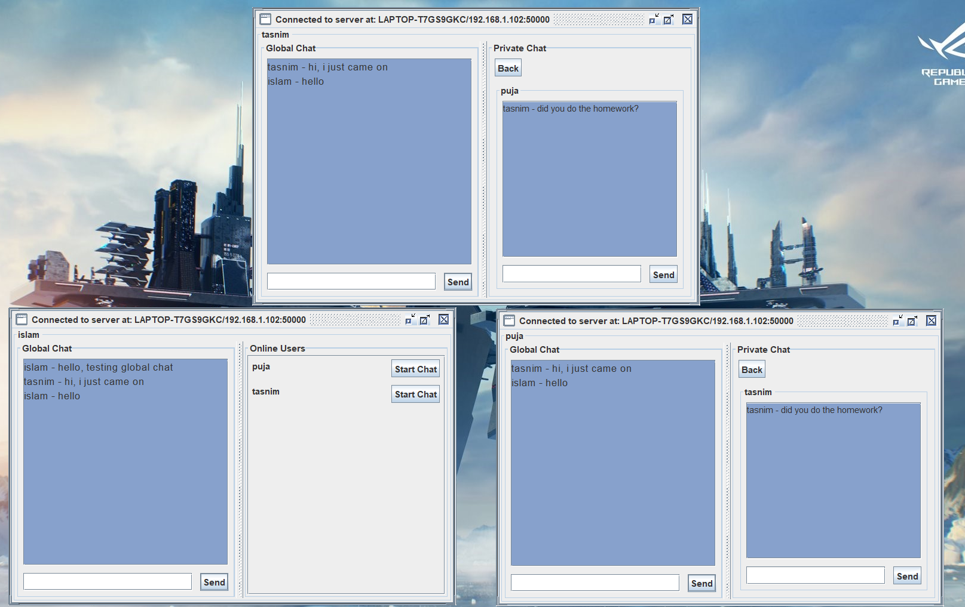
Concepts Implemented
Multiuser application

Slide 9
Suggestions for improvement & better end-result
Should be able to store users’ name and password to disk or other secure location.
Should be able to handle transfer of files by using thread pools and MIME detection to avoid race conditions
Should be able to log errors to external file on disk
Implement cell phone usage functionality (Android + Apple)
Better GUI representation

Slide 10

END
THANK YOU !!
LET’S RUN THE CODE!!!

